Slide 1
Capstone Project-3
Mobile Price Range Prediction
Team Members
Praveen Pal

Slide 2
Contents :
Data Exploration
Data Pre-processing 3.Data Cleaning 4.Univariate Analysis 5.Multivariate Analysis 6.Outlier Treatment 7.Feature Engineering 8.Standardization
9.K nearest neighbours model 10.Logistic regression model 11.XGBoost Classifier
12. Hyper parameter tuning 13.Model Explainability 14.Conclusion

Slide 3

Mobile Price Range Prediction
In the competitive mobile phone market companies want to understand sales data of mobile phones and factors which drive the prices. The objective is to find out some relation between features of a mobile phone(eg:- RAM, Internal Memory, etc) and its selling price. In this problem, we do not have to predict the actual price but a price range indicating how high the price is.

Slide 4
Attribute Information
Battery_power - Total energy a battery can store in one time measured in mAh Blue - Has bluetooth or not
Clock_speed - speed at which microprocessor executes instructions
Dual_sim - Has dual sim support or not
Fc - Front Camera mega pixels Four_g - Has 4G or not
Int_memory - Internal Memory in Gigabytes M_dep - Mobile Depth in cm
Mobile_wt - Weight of mobile phone N_cores - Number of cores of processor Pc - Primary Camera mega pixels Px_height - Pixel Resolution Height Px_width - Pixel Resolution Width
Ram - Random Access Memory in Mega Bytes
Sc_h - Screen Height of mobile in cm Sc_w - Screen Width of mobile in cm
Talk_time - longest time that a single battery charge will last when you are Three_g - Has 3G or not
Touch_screen - Has touch screen or not
Wifi - Has wifi or not
Price_range - This is the target variable with value of 0(low cost), 1(medium cost), 2(high cost) and 3(very high cost).

Slide 5
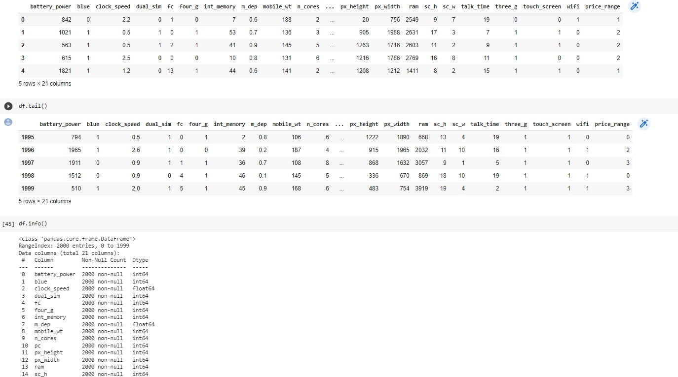
Exploring the dataset

Slide 6
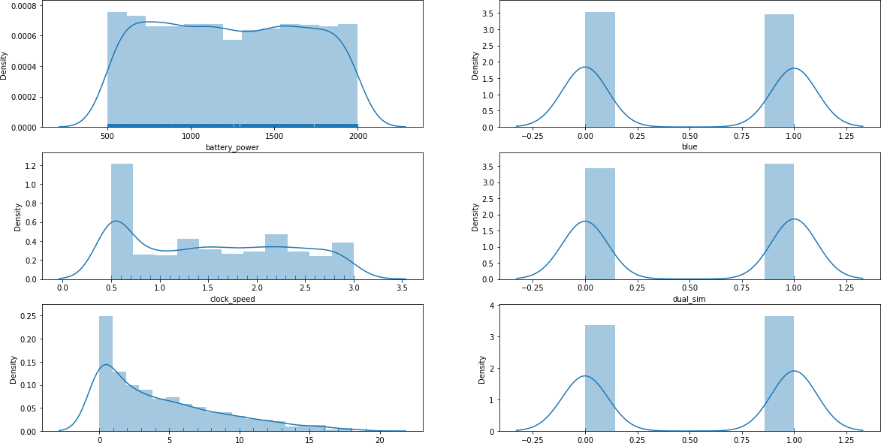
Exploratory Data Analysis

Slide 7
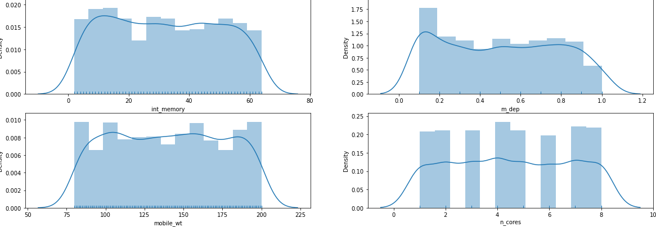
Exploratory Data Analysis

Slide 8
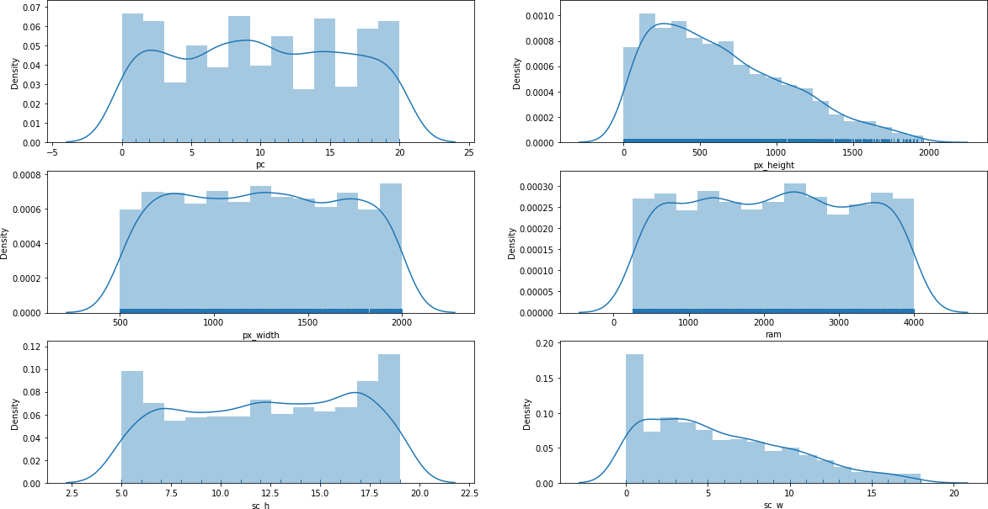
Exploratory Data Analysis

Slide 9
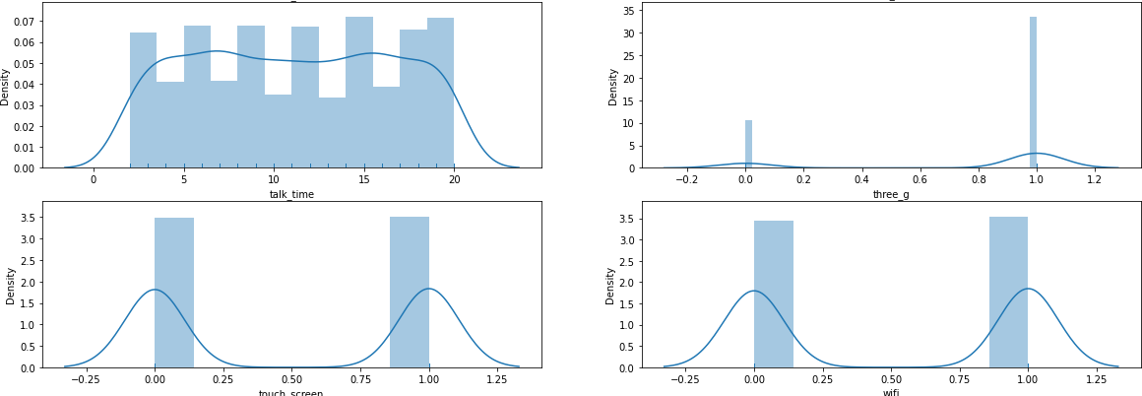
Exploratory Data Analysis

Slide 10
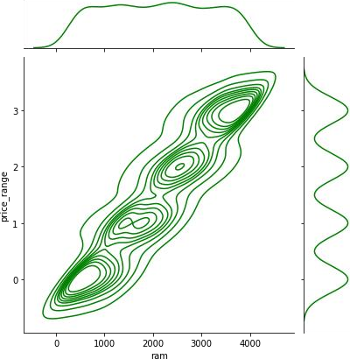
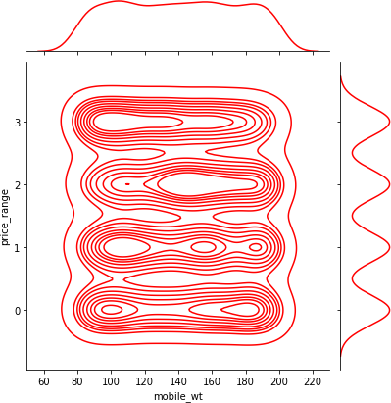
Exploratory Data Analysis

Slide 11
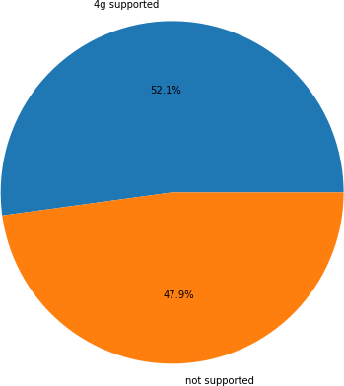
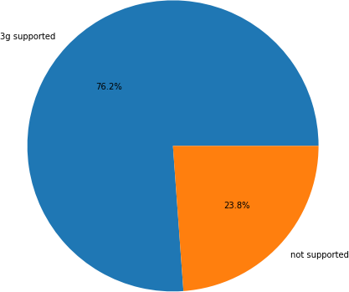
Exploratory Data Analysis

Slide 12
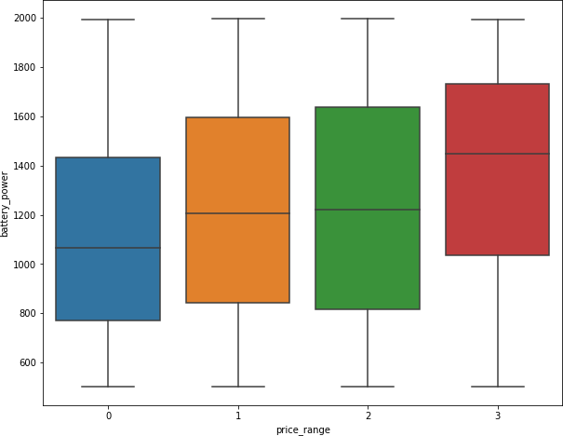
Exploratory Data Analysis

Slide 13
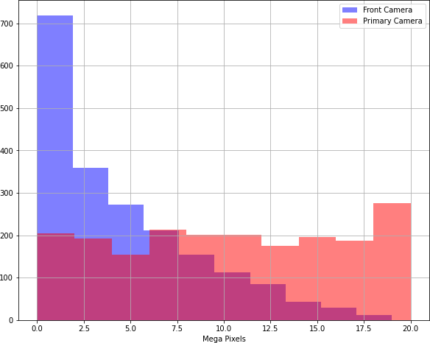
Exploratory Data Analysis

Slide 14
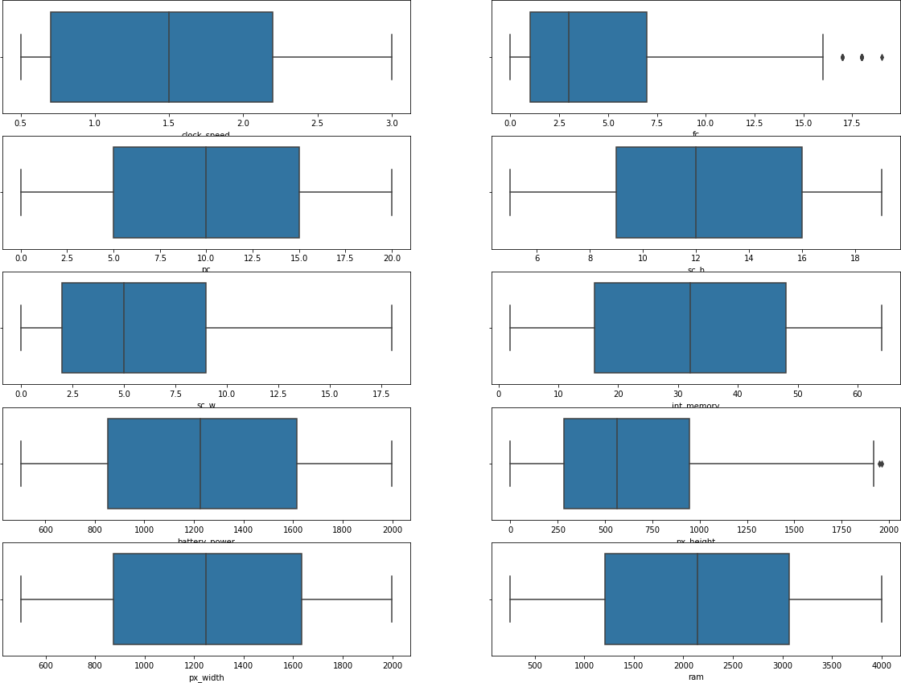
Outliers detection and treatment

Slide 15
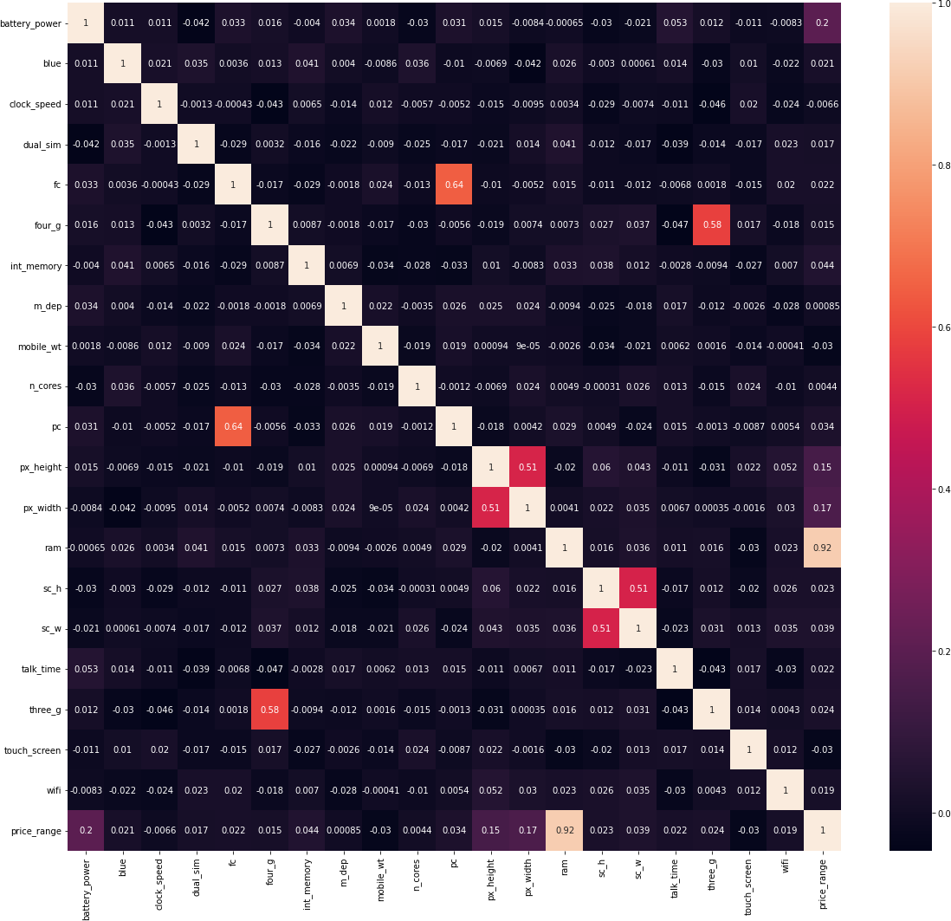
Correlation Heatmap

Slide 16
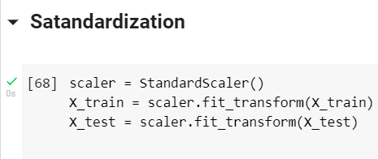
Standardization
Standardization is an important technique that is mostly performed as a pre- processing step before many Machine Learning models, to standardize the range of features of input data set.

Slide 17
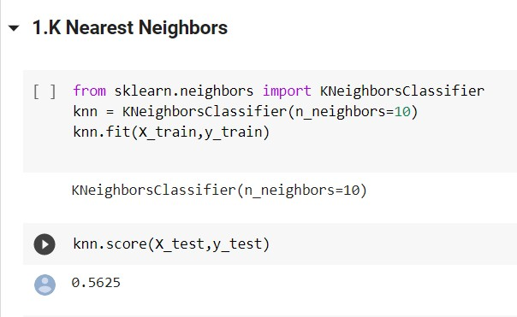
Machine Learning Modelling
1. K Nearest Neighbours
K-Nearest Neighbor is one of the simplest Machine Learning algorithms based on Supervised Learning technique.
K-NN algorithm assumes the similarity between the new case/data and available cases and put the new case into the category that is most similar to the available categories.
K-NN algorithm stores all the available data and classifies a new data point based on the similarity. This means when new data appears then it can be easily classified into a well suite category by using K- NN algorithm.
K-NN algorithm can be used for Regression as well as for Classification but mostly it is used for the Classification problems.
K-NN is a non-parametric algorithm, which means it
does not make any assumption on underlying data.

Slide 18
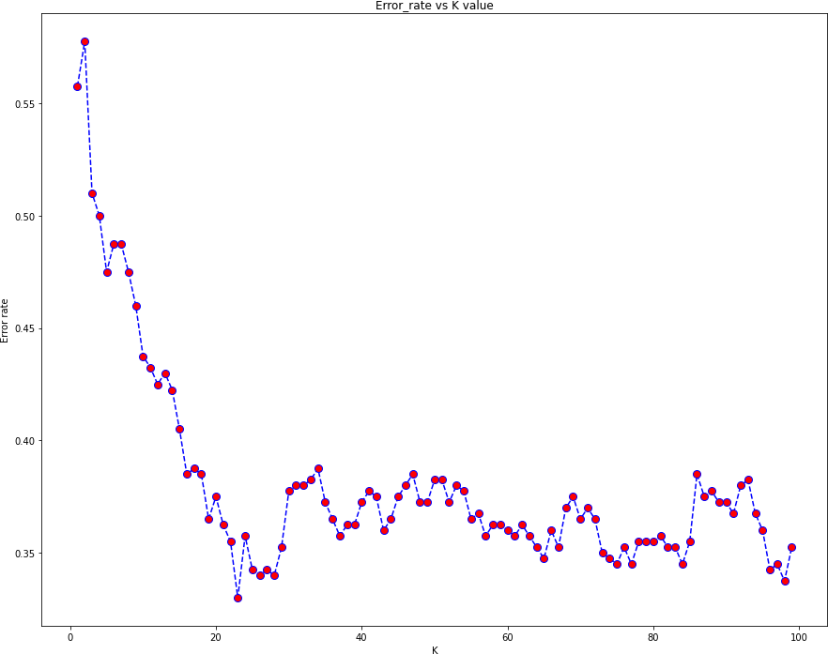
Elbow method for least error rate

Slide 19
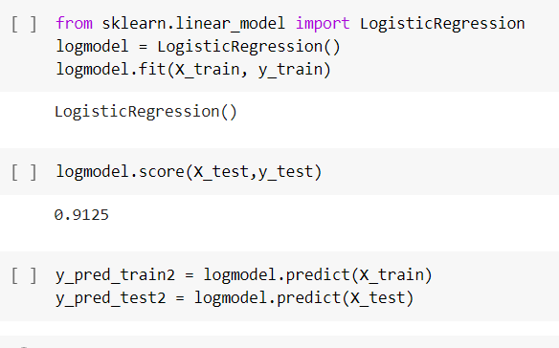
Machine Learning Modelling
2. Logistic Regression
Logistic regression is one of the most popular Machine Learning algorithms, which comes under the Supervised Learning technique. It is used for predicting the categorical dependent variable using a given set of independent variables.
Logistic regression predicts the output of a categorical dependent variable. Therefore the outcome must be a categorical or discrete value. It can be either Yes or No, 0 or 1, true or False, etc. but instead of giving the exact value as 0 and 1, it gives the probabilistic values which lie between 0 and 1.
Logistic Regression is much similar to the Linear Regression except that how they are used. Linear Regression is used for solving Regression problems, whereas Logistic regression is used for solving the classification problems.
In Logistic regression, instead of fitting a regression line, we fit an "S" shaped logistic function, which predicts two maximum values (0 or 1).

Slide 20
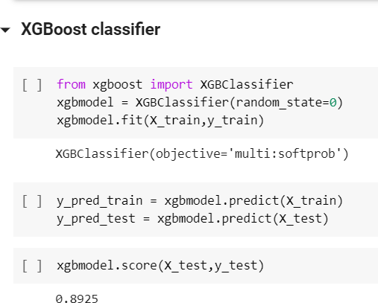
Machine Learning Modelling
3.XGBoost Classifier
XGBoost is a decision-tree-based ensemble Machine Learning algorithm that uses a gradient boosting framework. In prediction problems involving unstructured data (images, text, etc.) artificial neural networks tend to outperform all other algorithms or frameworks.

Slide 21
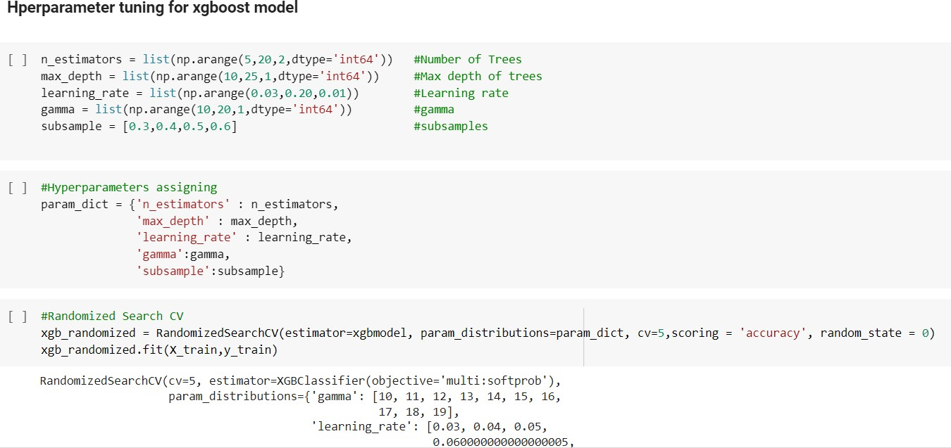
Machine Learning Modelling
Hyper-parameter Tuning

Slide 22
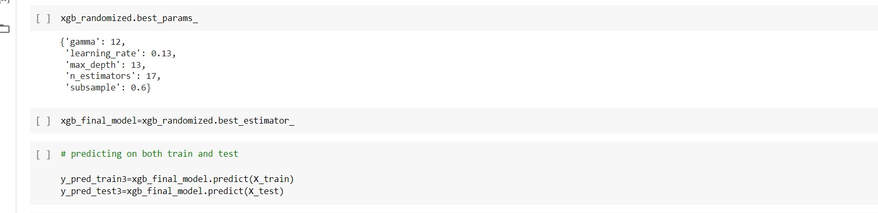
Machine Learning Modelling
Hyper-parameter Tuning

Slide 23
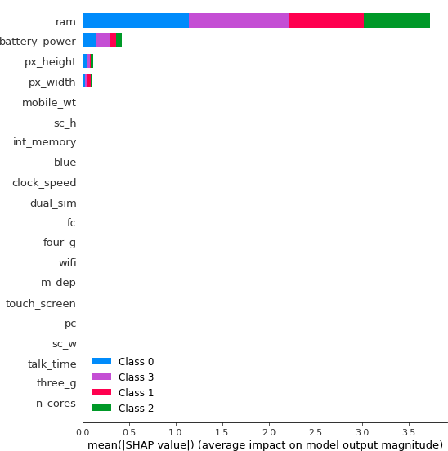
Model Explainability(Training Set)

Slide 24

Model Explainability(Test Set)

Slide 25
Conclusion
The 'price range' of the given dataset has equal distribution of the total number
of phones in each of the price range with 500 nos.
It isobserved that 76.2 percent are 3g supported and 27.8 percent are not supp orted.
It is observed that 52.1 percent are 4g supported and 47.9 percent are not
supported.
There is only few number of outlier in 'fc' column in feature engineering and we can neglect it as it has negligible amount.
During Multivariate analysis, in correlation heatmap, we get to see that 'ram is highly correlated with 'price range' thus inferring that 'ram' has high impact on p rice prediction.
In K nearest Neighbors classification model, we have got the knn score as 56.25%, accuracy score of 67% for training set and 65% for test set.

Slide 26
Conclusion
During 'elbow method' we have got the insight that the optimum value of k is 22 with least error rate.
In Logistic Regression Model, we have got the log score as 91%. accuracy score of 98% for training set and 91% for test set.
In XGBoost model the score was 89% before hyper parameter tuning.
RandomizedSearchCV is used for hyperparameter tuning in XGBoost classifier and the accuracy obtained after hyper parameter tuning was 86% for training set and 80% for test set.
Finally, in the model explaininabilty we have used shap and we got the insight that 'ram', 'battery power', and phone dimensions are the features which is deciding as key factor for the price range prediction.

Slide 27
References
https://pandas.pydata.org/
https://matplotlib.org/
https://seaborn.pydata.org/
Geek for geeks
Analytics Vindhya
6).XGBoost Documentation

Slide 28
Thank You

